Slide 1

Building an Empire With PowerShell
Will Schroeder (@harmj0y)
Notes:
You can write fully-functioning malware in PowerShell!

Slide 2
Agenda
Our Offensive Philosophy
Why build this?
Empire
Existing Offensive PowerShell
Architecture
Core agent
Modules
Detection

Slide 3
Our Offensive Philosophy
“Fundamentally, if somebody wants to get in, they're getting in...Accept that...What we tell clients is:
Number one, you're in the fight, whether you thought you were or not.
Number two, you're almost certainly penetrated. “
Michael Hayden
Former Director of CIA & NSA
Notes:
Mention the “Microsoft Enterprise Cloud Red Teaming” whitepaper
What I mean by “post-exploitation” and why we focus on it

Slide 4
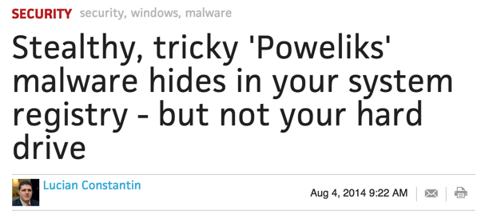
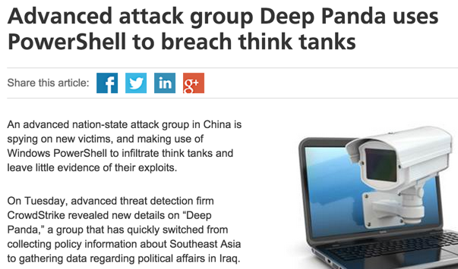
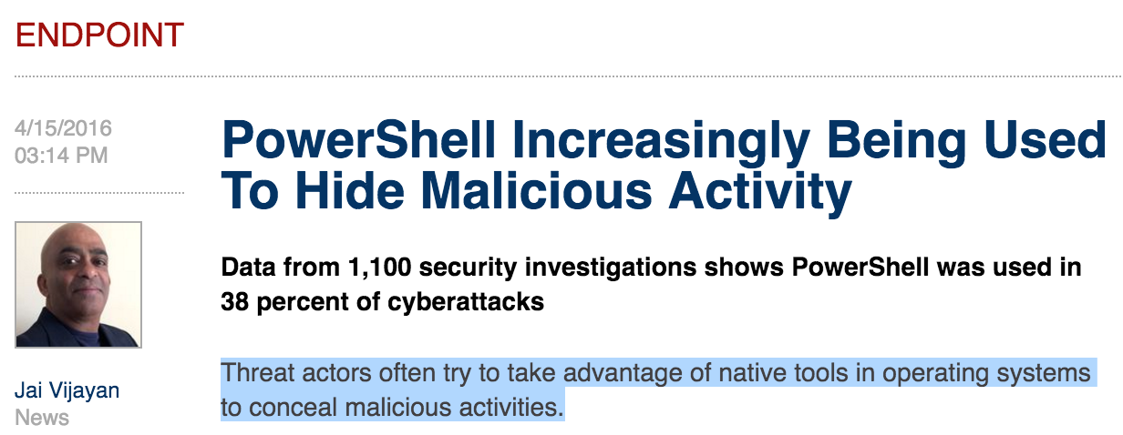
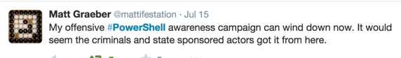
Empire Motivations

Slide 5
In Defense of Offense
We want to help secure companies against the level of threat that they’ve been unknowingly facing for over a decade
we need to be able to simulate at least some of the actions of these advanced groups
There is a balance between making tools that help simulate threats and providing help to the ‘real’ bad guys
Notes:
This is still an open question, what do you guys think?

Slide 6
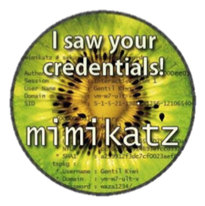
Existing Offensive PowerShell
PowerSploit (the ‘gold’ offensive standard):
Invoke-Mimikatz
Invoke-TokenManipulation
Invoke-Shellcode
Get-KeyStrokes
Get-TimedScreenshot
PowerView (advanced AD recon, see *tomorrow)
PowerUp (automated Windows privilege escalation)
Various persistence options (including WMI)
Notes:
Explain genesis and background, Matt Graeber, Chris Campbell, Joe Bialek
-we’ve started to build pester tests!
Empire builds very heavily on existing offensive PowerShell work
Google “unofficial guide to mimikatz” – on adsecurity.org
Demo functionality of various components

Slide 7
Empire
Empire is a richly featured, pure-PowerShell post-exploitation agent (or ‘RAT’/remote access tool)
It aims to solve the offensive ‘weaponization problem’ and integrates a large chunk of already existing offensive PowerShell work
An attempt to train defenders on how to stop and respond to PowerShell “attacks”
Notes:
Background on RATs themselves and how we use them
Explain the atomic units this is built on:
-in memory IEX download cradle
-secured key exchange
-packetized communications
-GET/POST communication structure (Net.WebClient and http[s])
-post-exploitation modules
Mention reactions – SourceFire’s emerging threat rules, vendors writing detection posts, etc.

Slide 8


The Empire Staging Process
Control Server
Client
1. GET /<stage0>
2. return key negotiation stager.ps1 w/ shared AES staging key
3. gen priv/pub keys, post ENCstaging(PUB) to /<stage1>
4. return ENCpub(epoch + AES session key)
5. decrypt session key, post ENCsession(sysinfo) to /<stage2>
6. return ENCsession(agent.ps1) patched with key/delay/etc. and register agent. Agent starts beaconing.
Notes:
the "staging problem"- somehow the code has to get to the target
“EKE” -> perfect forward secrecy and its implications
Demos!

Slide 9
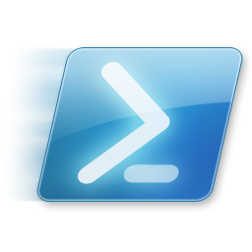

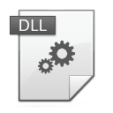

PowerShell Without powershell.exe
Invoke-PSInject
*.exe into process
ReflectivePick
“Download Cradle”
.NET Assembly
Notes:
Based on the “UnmanagedPowerShell” project by Lee Christensen
Reflective dll that loads up the .NET runtime into unmanaged code
Which we use to load up an Empire stager

Slide 10
Detection
Network detection:
High entropy byte strings in HTTP POSTs
Standard set of default request URIs- rules exist in Sourcefire/Snort
Netflow/heuristic analysis
Host:
Command line logging! –enc is weird
.NET Assemblies loaded into odd processes
WMF 5’s script block logging!
The new AMSI interface has us hackers worried a bit
Notes:
The future-
A RESTful API has been integrated into Empire 1.5
-This will open up integration into third-party projects
Empire’s communications are going to be modularized
-Think communications with established services
Modules and functionality keep being added by the community

Slide 11
Summary
PowerShell is Turing-complete
you can write fully functioning malware in it
‘real’ bad guys have been using these techniques for years
There is a wealth of *public* offensive PowerShell already out there
Empire functions as a weaponization vector
You can run PowerShell WITHOUT powershell.exe
Windows 10/WMF 5 provides a number of protections against these types of attacks
Notes:
The future-
A RESTful API has been integrated into Empire 1.5
-This will open up integration into third-party projects
Empire’s communications are going to be modularized
-Think communications with established services
Modules and functionality keep being added by the community

Slide 12
Questions?

Slide 13
About_Author
Will Schroeder (@harmj0y)
http://blog.harmj0y.net | will [at] harmj0y.net
Security researcher and red teamer for Veris Group‘s Adaptive Threat Division
Offensive open-source developer:
Veil-Evasion, Empire, PowerSploit
Recent Microsoft CDM/PowerShell MVP

Slide 14
About_References
Mimikatz (https://github.com/gentilkiwi/mimikatz)
By Benjamin Delpy (@gentilkiwi)
DCSync co-written by Vincent LE TOUX
PowerSploit (https://github.com/powershellmafia/powersploit)
Founded by Matt Graeber (@mattifestation) and Chris Campbell (@obscuresec)
Invoke-Mimikatz by Joe Bialek (@josephbialek)
UnmanagedPowerShell by Lee Christensen (@tifkin_)

